Slide 1
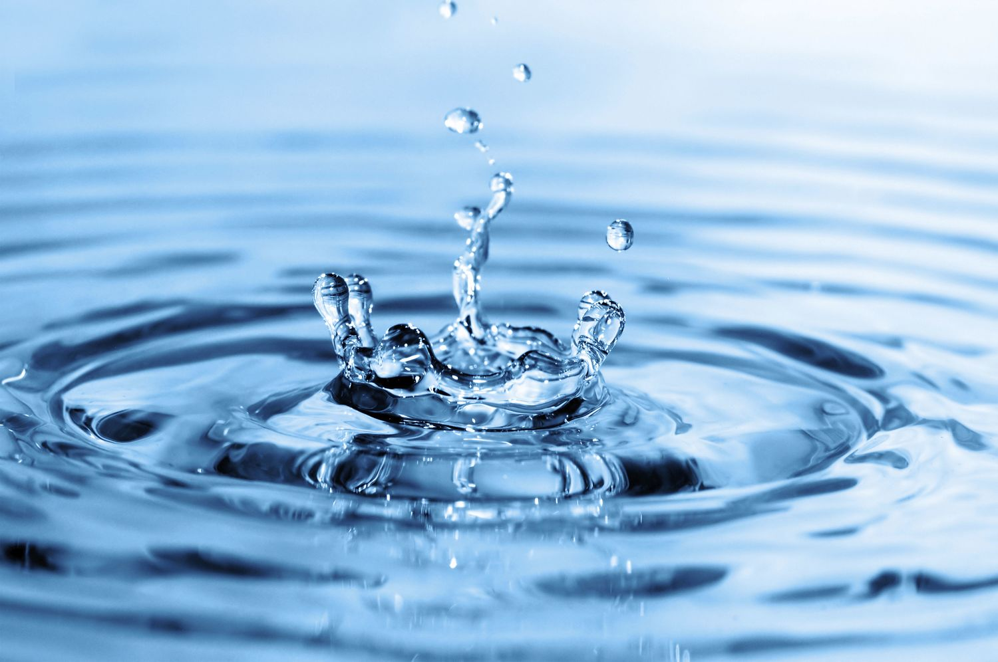
WATER
BY IZZY AND MILLY

Slide 2
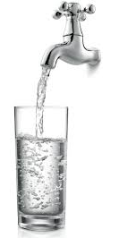
WHAT ARE WE LEARNING ABOUT??
In this presentation you will learn:
What the Water cycle is
World rivers
Countries in need of Water
Fun Water facts
Quiz and answers

Slide 3
THE WATER CYCLE
Water never leaves the Earth, it simply moves around the ‘water cycle’. The water cycle follows the journey of water from oceans, to clouds, to rain, to streams, to rivers and back into the ocean. Another word for it is the hydrologic cycle (hydro means water in Greek).
So, what happens?
When warmth from the sun hits water from the sea, lakes and rivers it rises into the air and turns to a gas called water vapour. This journey is called evaporation. The next stage of the water cycle is condensation. This happens when water vapour turns back into liquid, and forms clouds in the sky. Precipitation is next, and this happens when the clouds formed get so heavy that rain, snow, hail or sleet falls to the ground. Finally, runoff happens. This is the water that did not get soaked up into the soil after precipitation, or did not evaporate, and makes its way from the ground surface into places like rivers, streams, lakes and the sea.
Key:
TURQUOISE= scientific words

Slide 4
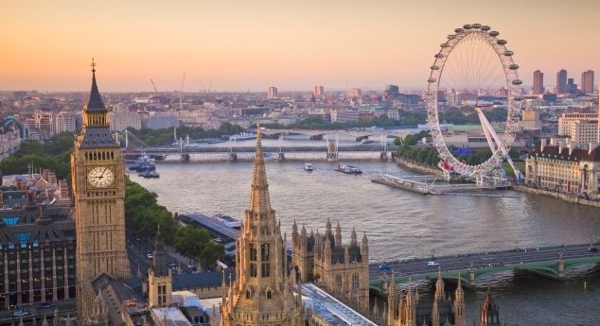
WORLD RIVERS
The River Thames
At 215 miles long, the River Thames is the longest river in England, and the second longest in the United Kingdom. The River Thames makes up is two-thirds of London’s drinking water. It is said that at least eight people will drink a drop of rain falling into the Thames at its source in the Cotswolds before it flows into the rivers mouth.
Fun Facts
Over 200 bridges cross the river. The first was built in London by the Romans almost 2,000 years ago, where London Bridge is now. Westminster Bridge is painted the same shade of green as the leather benches in the House of Commons.

Slide 5
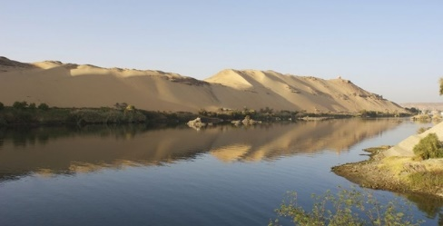
WORLD RIVERS
The Nile
The Nile is in Africa and is about 6853km (4160 miles) long. It is the second longest river in the world and flows into the Mediterranean sea. In 2004, an expedition called the White Nile was the first to travel their way down the Nile. It took 4 months and 2 weeks to complete their journey. Today, 50 million people live within a few miles of the river, and depend on its water. The river is home to lots of fish which is the local’s food supply. The ancient Egyptians invented a number of different ways to bring water from the Nile up onto land.
Fun Facts
The Ancient Egyptians called the Nile the Great River. The north part of the river flows through a desert. The Nile’s name comes from the Greek word ‘neilos,’ that means valley.

Slide 6
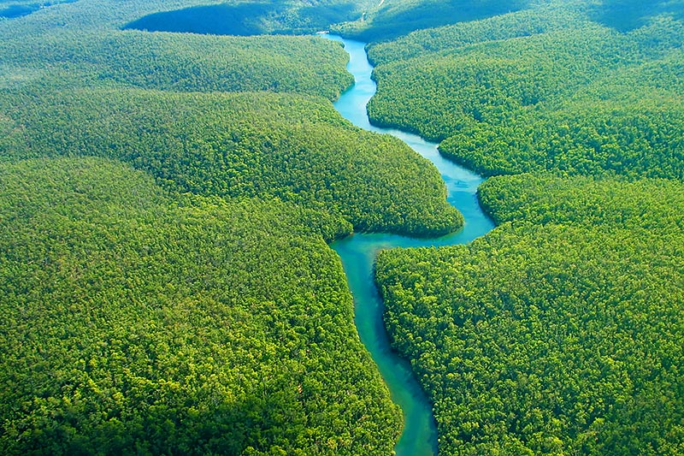
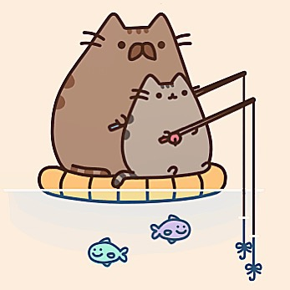
WORLD RIVERS
The Amazon
The Amazon river is about 4000 miles long.It is in in South America. It runs through Guyana, Ecuador, Venezuela, Bolivia, Brazil, Colombia and Peru.
Anacondas live in the shallow waters of the Amazon, they are one of the largest snakes in the world and sometimes attack larger animals such as goats that are near the water.
There are over 3000 known species of fish that live in the Amazon River, with more constantly being discovered.

Slide 7
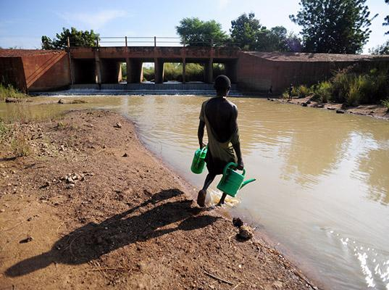
COUNTRIES IN NEED OF WATER
If you went to a tap and turned it on you would get running water but in many homes across the globe don’t have that. In many countries people have to walk for miles to get to water; water that may not even be clean. Nearly one billion humans do not have access to clean, drinkable water. And 2.5 billion people don’t have access to a toilet .
Here are just a few of those countries:
Afghanistan (only 13% of this country's water is drinkable);
Ethiopia (sometimes people will have to walk up to 6 hours to collect water that might be contaminated);
Cambodia ( 84% of Cambodia’s population do not have access to clean, safe, drinkable water);
Ghana ( many families lack access to safe water: which means that waterborne diseases are common in this area).
WATERAID:
One of the many water charities is WaterAid. This charity helps give
taps to countries in need of fresh, clean water to drink.You can donate from £2 to £20.

Slide 8
FUN WATER FACTS
75% of a living tree is water. 75% of a human is also water.
Nearly 97% of the world’s water is salty or undrinkable.
The water from your tap
could contain molecules
that dinosaurs drank.
In the Pacific Ocean, the Mariana Trench is the deepest known part of the world’s oceans.
Water covers around 70% of the Earth’s.
68.7% of the freshwater on Earth is trapped in glaciers.
There is the same amount of water on Earth as there was when the Earth was formed.
Human blood is 83% water
Humans can tell the difference between cold water being poured into a glass and hot water being poured into a glass.
Water expands by 9% when it freezes.

Slide 9
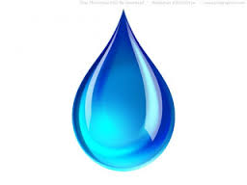
QUIZ
Please get out your whiteboards and do this short quiz. You will have a few minutes to finish it:
What order do precipitation,runoff,condensation and evaporation go in the water cycle?
How many miles long is the River Thames in London?
How many known species of fish live in the Amazon river?
How much of a living tree is made up of water?

Slide 10
QUIZ ANSWERS
Evaporation, Condensation, Precipitation, Runoff.
215 miles long.
Over 3000.
75%.

Slide 11
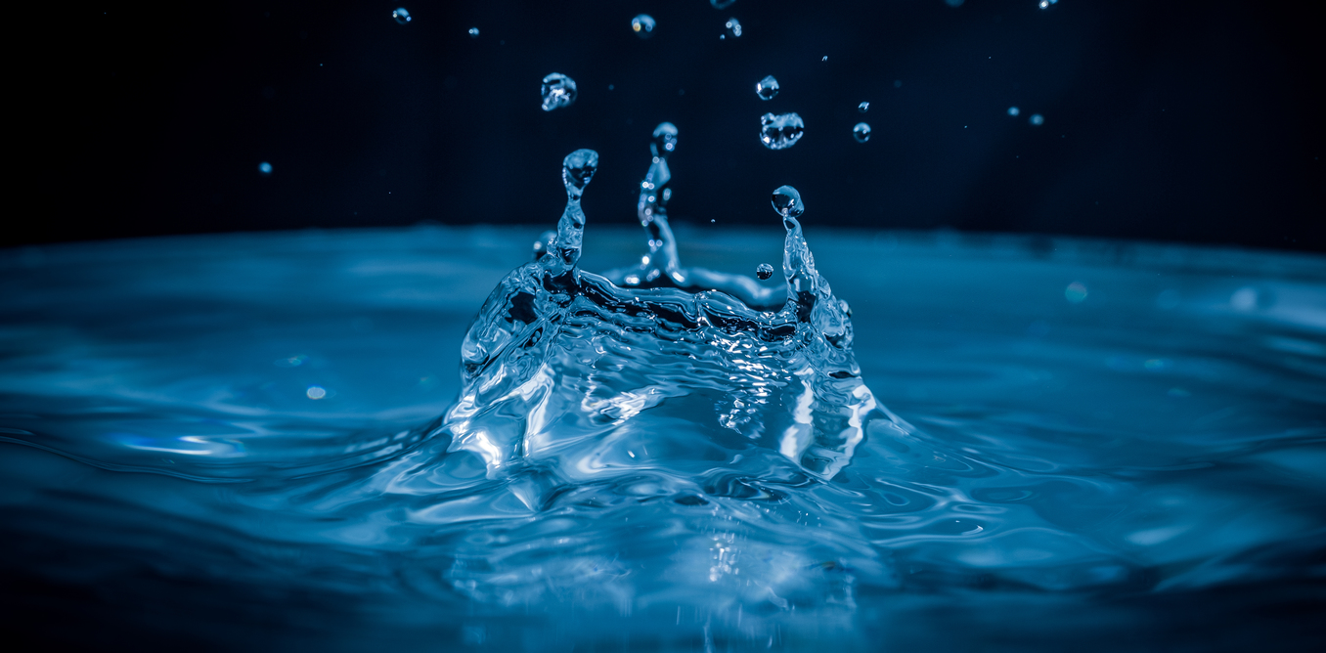
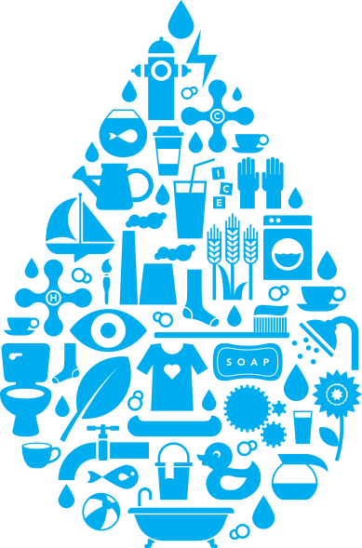
THE END

