Slide 1

Year 4 | Week 9 | Day 1

Slide 2
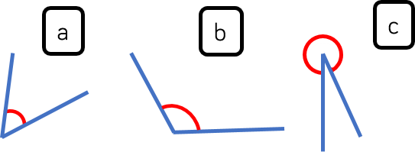
Year 4 | Week 9 | Day 2

Slide 3

Year 4 | Week 9 | Day 3

Slide 4
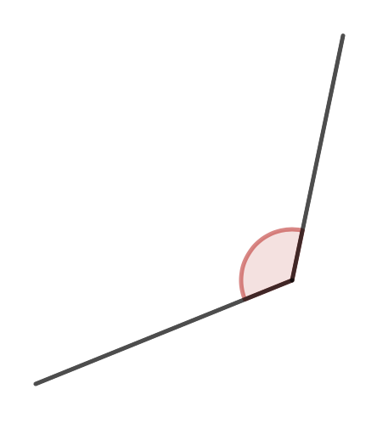
Year 4 | Week 9 | Day 4

Slide 5


Year 4 | Week 9 | Day 5

