Slide 1
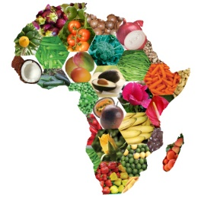
A Taste of Africa Find out more about some traditional African foods.

Slide 2
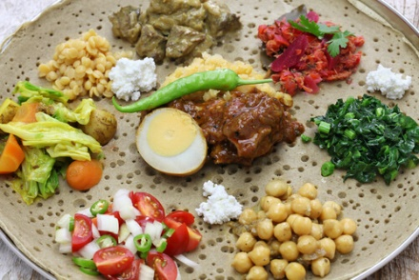
Ethiopia
Chickpeas, beans or corn are common in dishes as are beef, lamb and fish.
Other traditional Ethiopian foods:
Tips: fried meat and vegetables.
Kitfo: minced raw beef meat that has been marinated in spices.
Wat: fried onion and spices mixed with vegetables or meat.
Genfo: porridge usually made with wheat or barley and traditionally eaten for breakfast.
Injera is a large flatbread made with teff flour. Teff is a cereal (like wheat or barley) that only grows in Africa.
Injera is served with most meals.

Slide 3
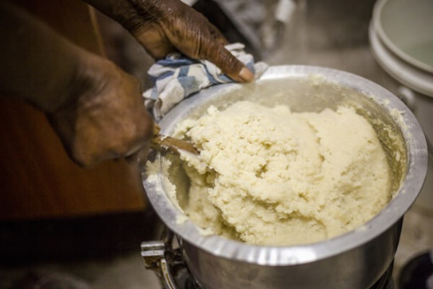
Kenya
Other traditional Kenyan foods:
Sukuma wiki: Cabbage cooked with onions and a variety of spices.
Nyama choma: Grilled meat usually served with sukumi wiki, roast potatoes, kachumbari and chapati (flatbread).
Kachumbari: Salsa made with chopped onions mixed with tomatoes and peppers.
Githeri: Vegetarian stew prepared with corn and kidney beans.
Vibibi: Coconut and rice pancakes are a delicious breakfast treat!
Chapati: flatbread made with flour, oil, water and salt and fried in oil or grilled over open fire.
Ugali is made from ground maize and water.
It is often cooked over an open fire and looks a like a stiff porridge. It is usually eaten with stew, mushy peas or sukuma wiki.

Slide 4
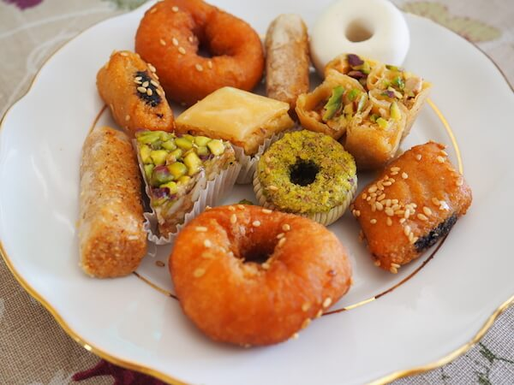
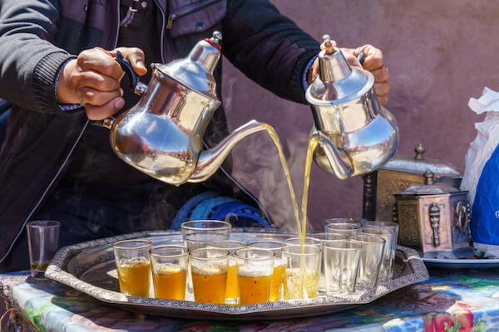
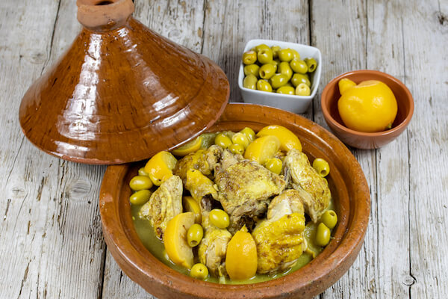
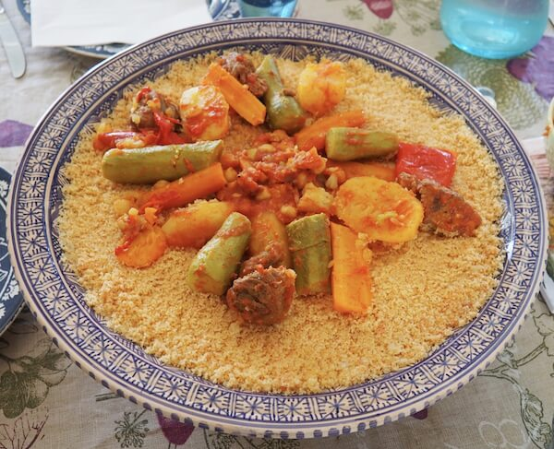
Tunisia and Morocco
Spices, dried fruit, dates, honey and flower buds are used a lot in Tunisian and Moroccan food.
Tagine: a meat or vegetable spicy stew cooked in a special clay pot that is covered with a cone shaped lid.
Makroudh: typical Tunisian sweet pastries.
Mint tea: sweet tea made with fresh mint leaves. People drink it at any time of the day.
Other foods from Tunisia and Morocco:
Harira: soup made with vegetables, lentils or chickpeas.
Harissa: fiery red sauce made with tomatoes and chillies.
Kofta: minced meat patties (mainly lamb) with onions and spices.
Lablebi: chickpea soup.
Couscous: cooked grains often served with stews or tagines.

Slide 5
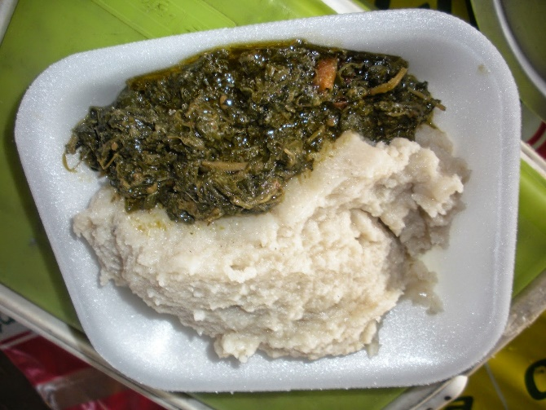
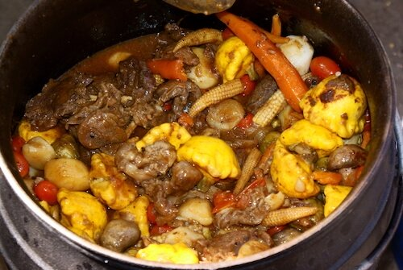
Namibia
Oshithima: a type of pap (thick cornmeal porridge eaten with the hands).
Ombonga: a type of wild spinach that grows in Namibia during rainy seasons.
They are flavoured with Ondjove oil which is made from Marula tree seeds. Ondjove oil is considered an expensive treat.
Other foods from Namibia:
Braaivleis: grilled BBQ-meat.
Mopane worms: crispy fried caterpillars!
Kapana: grilled meat strips, usually sold in street markets, can be made with any kind of meat.
Potjiekos: slow cooked stew made with vegetables and meat in a heavy cast iron pot, over the open fire.

Slide 6
A Taste of Africa Did you recognise any of the food? Are there any foods that you would like to try? Suggested task:
Draw and label some of the cooked foods. Can you find out what the raw ingredients are and draw those too?

