Slide 2
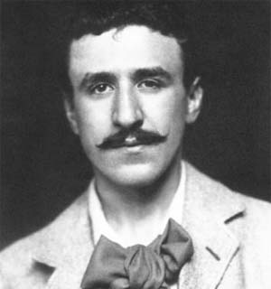
Charles Rennie Mackintosh
Charles Rennie Mackintosh was born in Glasgow on 7th June 1868.
Charles became an apprentice architect for a company in Glasgow. He enrolled in evening classes at Glasgow School of Art in the 1890s. His talent grew and he won prizes for his work, including an award that allowed him to take a tour of Italy to study the architecture.
Charles also met three friends at the School of Art. The group became known as ‘The Four’. They were Charles, James Herbert McNair, and the sisters; Margaret and Frances Macdonald. They produced new art and designs which became known as the ‘Glasgow Style’. In 1899 McNair and Frances Macdonald married. Charles married Margaret Macdonald the following year.

Slide 3
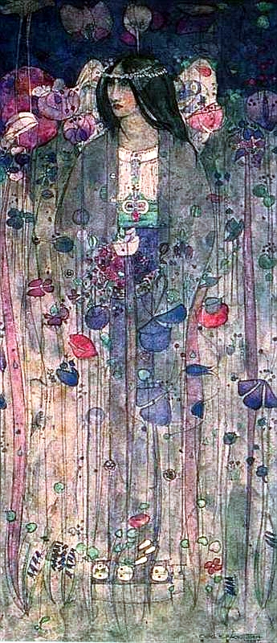
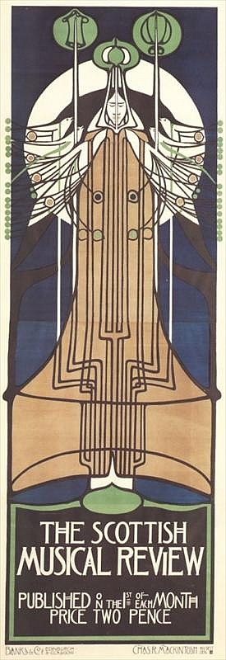
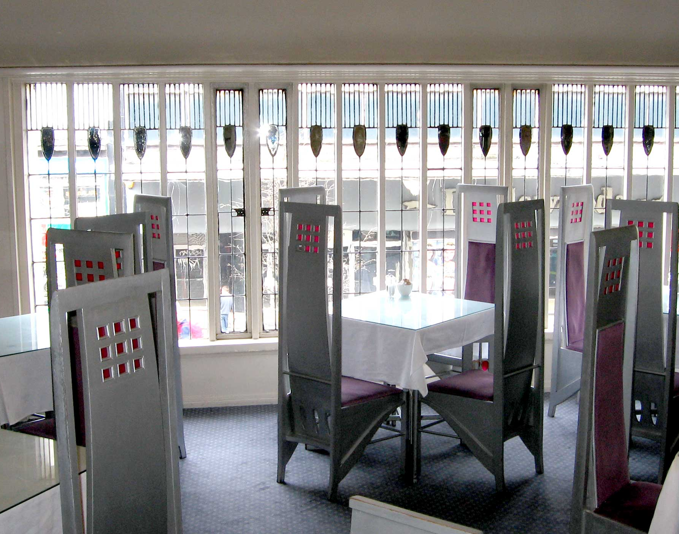
Charles Rennie Mackintosh
As well as architecture, Mackintosh designed furniture and produced other art work such as posters and water colours.
The Room de Luxe at The Willow Tearooms, Glasgow
Designed 1903
In Fairyland, Watercolour,
1897
Scottish Musical Review, Poster 1896
Photos granted under creative commons licence, wikimedia - attribution

Slide 4
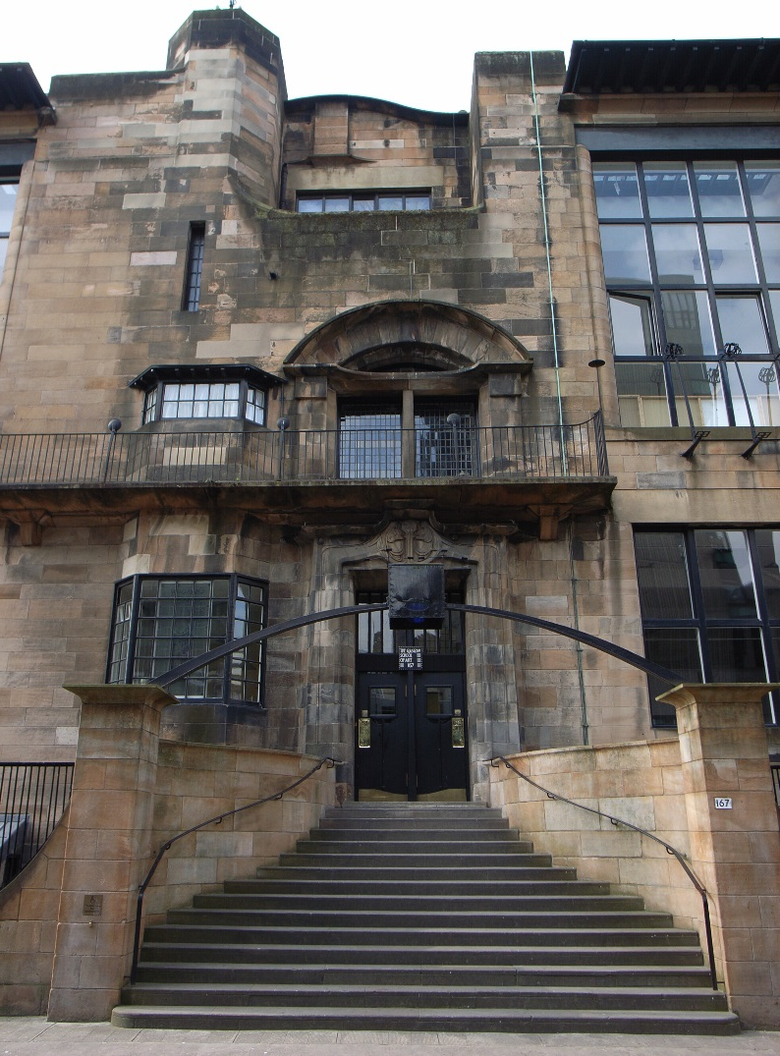
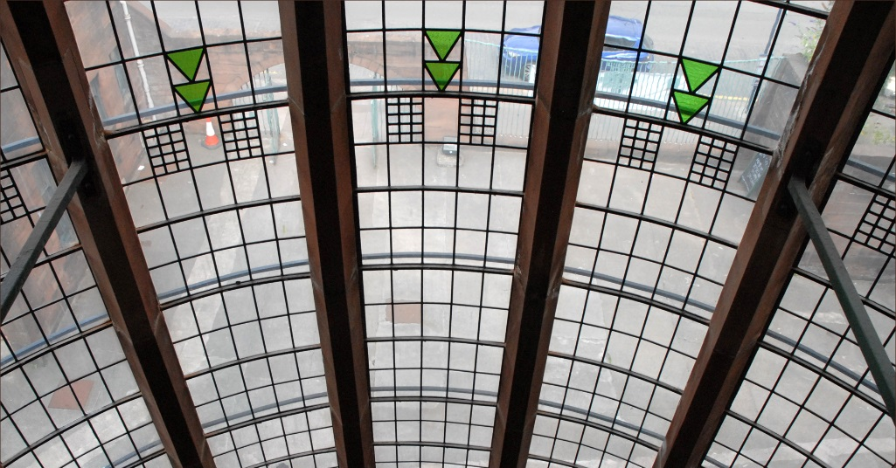
Charles Rennie Mackintosh
In 1896 he was asked to design a new building for the Glasgow School of Art. He designed Glasgow’s Queen’s Cross Church and the Scotland Street School. Mackintosh also designed two large private houses, 'Windyhill' in Kilmacolm and 'The Hill House' in Helensburgh.
Scotland Street School Windows
Glasgow School of Art
Photos courtesy of Jean-Pierre Dalbera (@flickr.com) - granted under creative commons licence - attribution

Slide 5
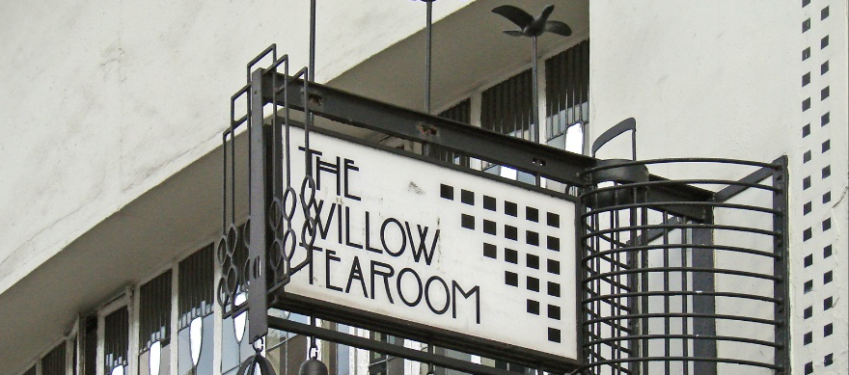
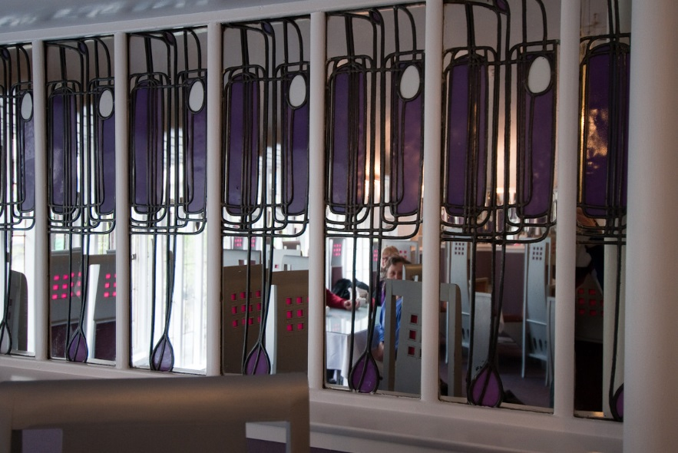
Charles Rennie Mackintosh
A Glasgow woman, Miss Catherine Cranston, asked Mackintosh to design the interior of her tearooms. These were designed and furnished between 1896 and 1917.
This opportunity gave Charles the freedom to experiment with his designs. He provided the tearooms with furniture (including his famous high-back chairs), light fittings, wall decorations and even the cutlery. You can still visit the tearooms in Glasgow today.
Miss Cranston’s Tearooms
Photos courtesy of Jean-Pierre Dalbera and Asbjorn Fioden (@flickr.com) - granted under creative commons licence - attribution

Slide 6
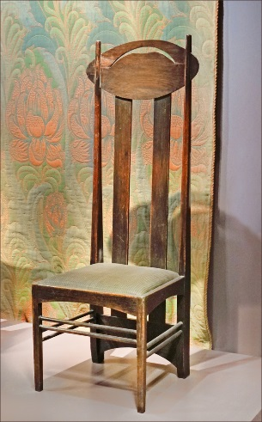
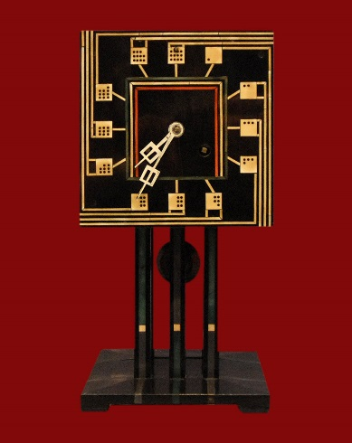
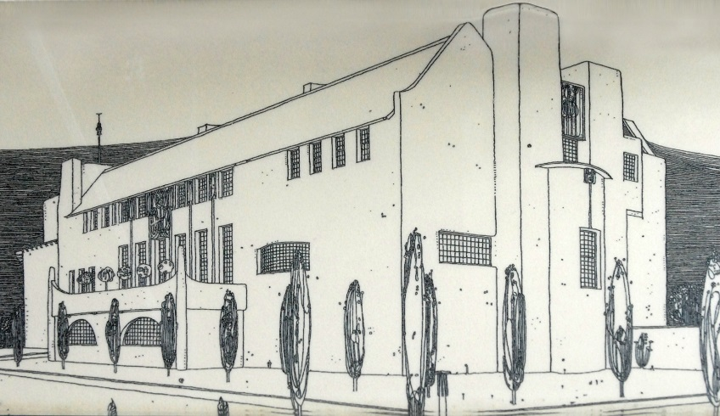
Charles Rennie Mackintosh
In his own lifetime Mackintosh had just a handful of supporters and his work was not well known in Scotland. In Europe, however, Mackintosh's style was quickly appreciated and in Germany and Austria his work received the status that he never truly gained at home.
Mackintosh’s designs were influenced by geometric shapes, the natural world, Scottish Baronial architecture, Celtic and Japanese art.
Chaise de Charles Rennie Mackintosh
1847
Domino Clock
1917
Design for House for an Art Lover
1901
Photos courtesy of Jean-Pierre Dalbera (@flickr.com) and wikimedia - granted under creative commons licence - attribution

Slide 7
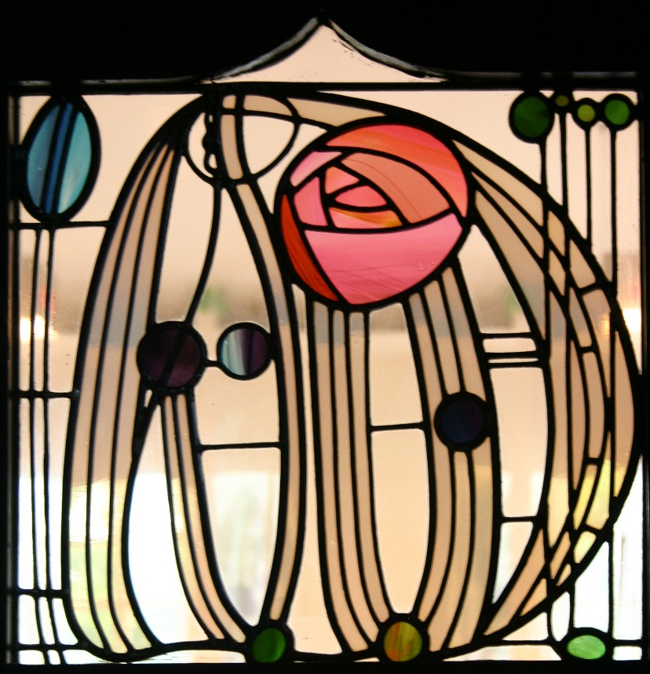
Charles Rennie Mackintosh
Today Mackintosh-influenced artworks and designs, like his rose design, have become hugely popular and can be found on anything from fabric, to home accessories, stained glass, bags, wallpaper, to furniture, jewellery and even food!
Mackintosh died in London on December 10th 1928.
Photos courtesy of Tony Hisgett (@flickr.com) - granted under creative commons licence - attribution

